Slide 1
Work at Olist
Data Engineering Test

Slide 2
INSTRUCTIONS FOR USE
EDIT IN GOOGLE SLIDES
Click on the button under the presentation preview that says "Use as Google Slides Theme".
You will get a copy of this document on your Google Drive and will be able to edit, add or delete slides.
You have to be signed in to your Google account.
EDIT IN POWERPOINT®
Click on the button under the presentation preview that says "Download as PowerPoint template". You will get a .pptx file that you can edit in PowerPoint.
Remember to download and install the fonts used in this presentation (you’ll find the links to the font files needed in the Presentation design slide)
More info on how to use this template at www.slidescarnival.com/help-use-presentation-template
This template is free to use under Creative Commons Attribution license. You can keep the Credits slide or mention SlidesCarnival and other resources used in a slide footer.

Slide 3

HELLO!
I am Tiago Pichi Barboza
I’ll present you my ETL approach with the work-at-olist datasets.
You may find me at
www.linkedin.com/in/tiagopb

Slide 4
Initial thoughts after seeing the work-at-olist-data repository
Analyze datasets structure using Pandas
Architect normalized DER diagram
Create database
Extract data from datasets and load normalized data to database
Initiate data analysis based on suggestions

Slide 5
Analyze datasets structure using Pandas
1
First impressions about the presented data

Slide 6
Create basic environment for analysis
I’ve forked the github.com/olist/work-at-olist-data to github.com/tbarboza/de-analysis. Started a new python enviroment wihtin it using :
Python 3.7
Jupyter
Pandas
Numpy

Slide 7
Initial Analysis
Jupyter notebook of initial analysis is located at:
de-analysis/eda/Datasets Analysis for db preparation.ipynb
Key first impressions:
Data redundancy (e.g.: Zip, city and state repeats in 3 tables)
Information redundancy (e.g.: Table names repeats in columns names)
Identificators in plural form instead of singular
Data interdependency
Possibility of data normalization over new database ER model on relational Database
Order reviews have some strings, with commas within, not restricted by double quotes, which is breaking data load

Slide 8
Architect normalized DER diagram
2

Slide 9
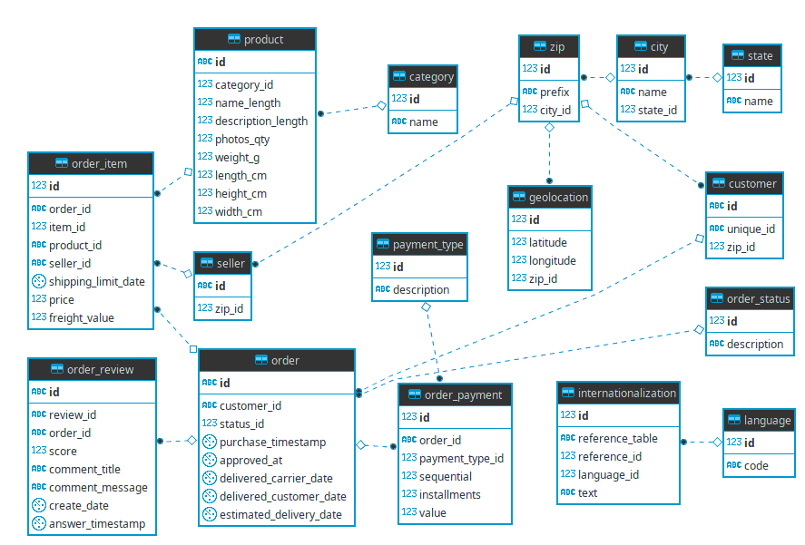
Proposed Database Model

Slide 10
Create Database
3

Slide 11
New database DDL
The DDL for database and model creation is located at de-analysis/sql/DDE.ipynb
Chosen database is Postgres on AWS RDS

Slide 12
Extract data from datasets and load normalized data to database
4

Slide 13
The normalized data DML
The DML for normalized data is located at de-analysis/sql/DML.ipynb

Slide 14
Initiate data analysis based on suggestions
5

Slide 15
DB Data Analysis
The data analysis based on the loaded normalized data is located at de-analysis/eda/Database loaded data analysis.ipynb
Focus on SQL queries
Presented in different ways, from simple loop prints under conditions up to charts based on pandas datasets

Slide 16
Space for improvements
Due time constraints (my current job is demanding), I understand that there were more that could be done, as well as areas for improvement, which I’d like to list some to show that I acknowledge it.
Correios DNE
  The cities table was loaded by merge of all cities in 3 datasets, however they have typos causing duplications. With DNE in hands, we could create a normalized dataset using the ZIP prefix as indexes
Further database normalization
  Some tables (e.g. Order) is the same as a reserved word in SQL language. I used these names to try to keep close to original schema and make this tech interview review easier, however ideal is to choose new names which do not conflict with reserved words
More data extraction and analysis based on other proposals in work-at-olist-data README.md.
Create REST API (or maybe GraphQL) and a dashboard

Slide 17
Links
Datasets
  https://github.com/olist/work-at-olist-data
Analysis Source
  https://github.com/tpbarboza/de_analysis
RDS
  Database-1.chcqqyli2cjd.us-east-2.rds.amazonaws.com
  PORT 5432

Slide 18

THANKS!

